Slide 1
Please Read
This PowerPoint presentation needs to be viewed in "Slide Show" view, because it contains effects, animations and interactions.
If a presenter elects to view it in "Normal" view, some slides will display with layers of text and/or graphics and may not be legible.
Notes:
Please Read

Slide 2
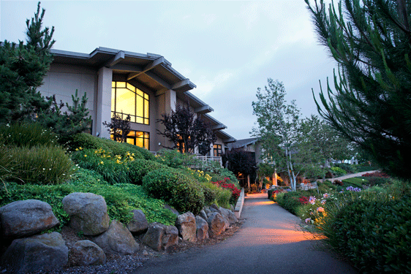
Developed with the generous support of The
SCAN Foundation
Our Mission
To prevent and relieve suffering and promote quality of life, at every stage of life, through patient and family care, education, research and advocacy.
Learn more at www.palliativemed.org
Project Lead
Paula McMenamin, MSW
Content Experts
Connie Carr, CNP
Frank Ferris, MD Paula McMenamin, MSW
JJ Nadicksbernd, MSW
Patricia Strunk, RN MSN
Instructional Designers
Barbara Greenstein, MA
Kendra Haddock, MA
Lisa Wortman, MA
Narration
Jessica Barr, BS

Slide 3
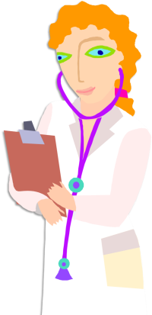
Care at the End of Life
Module 3: After Death
Module 1: Managing Resident Care
Module 2: Preparing the Family
Module 3: After Death
Bite 1:
Care of the Body
Bite 2:
Supporting a Grieving Family
Bite 3:
Grief
Bite 4:
Community Response to Death
IMPORTANT: Every state has different laws regulating LTC, and it is your responsibility to know your specific job duties. The content presented in this course is comprehensive and not tailored to meet the specific needs of LTC professionals in any one state. If you are unsure how it applies to you, ask your supervisor.
Notes:
Bite 1- Care of the Body
Bite 2- Supporting a Grieving Family
Bite 3- Grief
Bite 4- Community Response to Death

Slide 4
Care of the Body
Module Three| Bite 1

Slide 5
At the end of Bite 1 you will be able to
Assess the six signs of death
Identify who can legally pronounce a resident dead
Explain the goal of post-mortem activities
Summarize post-mortem activities

Slide 6
Reflect On It
Have you taken care of a resident after they have died?
How did you feel about it?

Slide 7
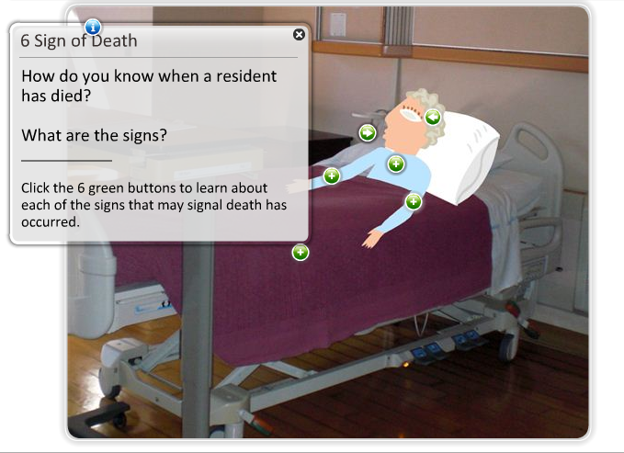
6 Signs of Death

Slide 8
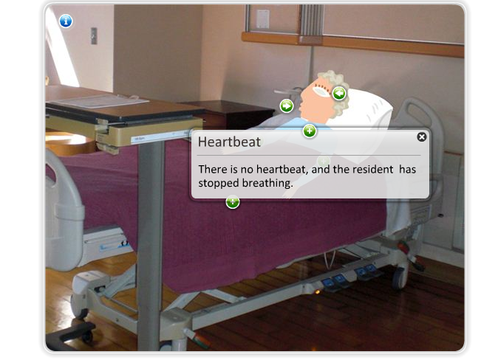
6 Signs of Death

Slide 9
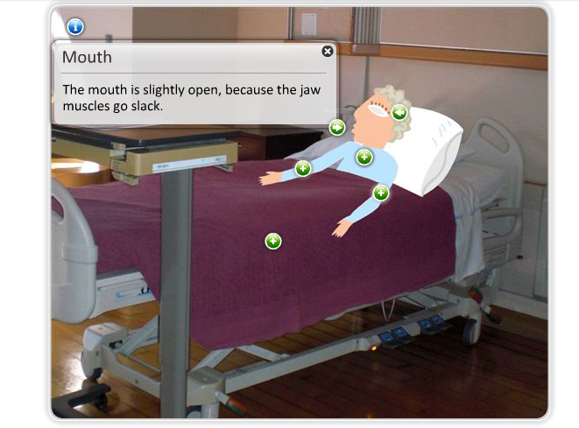
6 Signs of Death

Slide 10
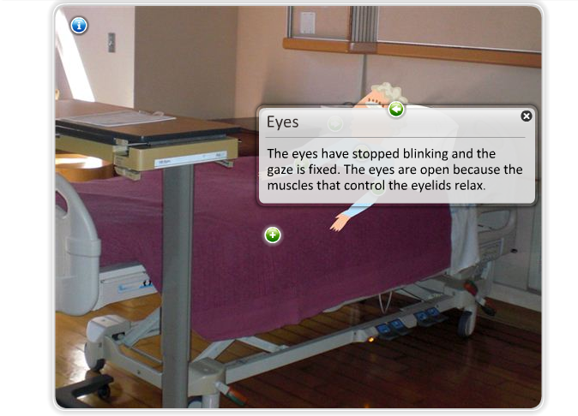
6 Signs of Death

Slide 11
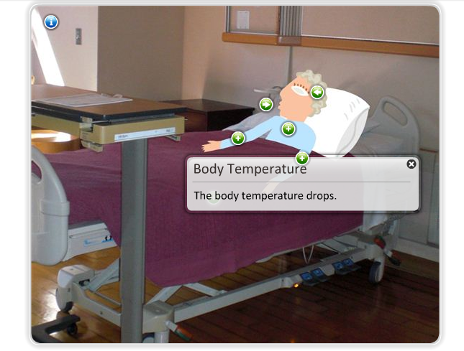
6 Signs of Death

Slide 12
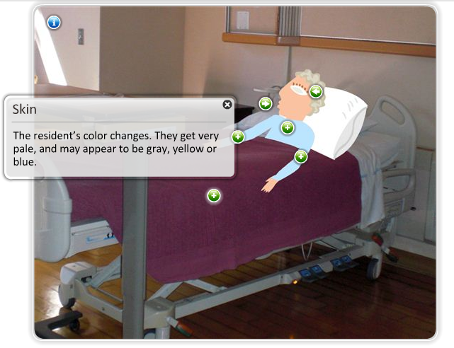
6 Signs of Death

Slide 13
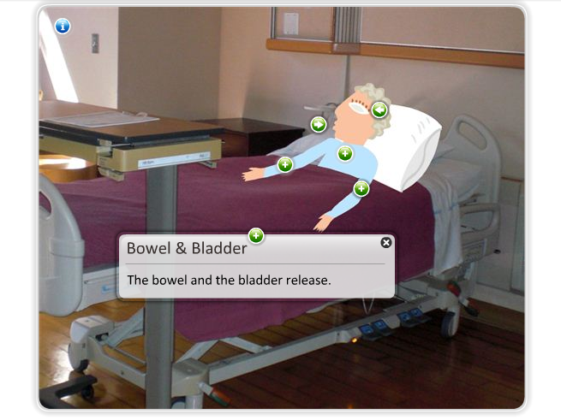
6 Signs of Death

Slide 14
Pronouncing Death
Skilled Nursing Facility
Staff Nurse
Residential Care Facility
Hospice
Private Home
The Family

Slide 15
Post-mortem Care
creating a comfortable environment for the resident’s family
Close the eyes and mouth
Cleanse the body
Change the bed sheets
Position the body in the bed
Control odor with aromatherapy or air freshener

Slide 16
Case Story #1
Recently you have been caring for Mrs. Bernstein, who has been actively dying for two days. Her family is at the bedside and is tearful, but appear to be coping appropriately. As you enter the room to check on the resident, you note that she does not appear to be breathing and may have just died. The family also notices that she no longer appears to be breathing and asks you anxiously if she has died.

Slide 17
Supporting a Grieving Family
Module Three| Bite 2
Notes:
Supporting a Grieving Family
Module 3, Bite 2

Slide 18
At the end of Bite 2 you will be able to
State comforting words you can say to support a grieving family
Apply actions you can take to support a grieving family

Slide 19
Focusing on the Family
Post mortem care

Slide 20
Focusing on the Family
Post mortem care
Call them to the bedside

Slide 21
Focusing on the Family
Expect a strong reaction
Post mortem care
Call them to the bedside

Slide 22
Focusing on the Family
Cultural considerations
Expect a strong reaction
Post mortem care
Call them to the bedside

Slide 23
Focusing on the Family
Be supportive
Cultural considerations
Expect a strong reaction
Post mortem care
Call them to the bedside

Slide 24
Support With Words
I’m sorry for your loss.
Can I get you some water?
I know this is a hard time for you.
Is there anyone I can call for you?

Slide 25
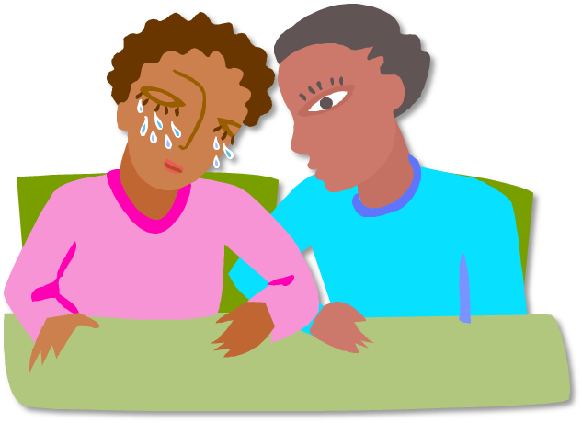
Support With Actions
Be calm
Offer a hug
Hold a hand
Sit with them
Encourage feelings
Be patient

Slide 26
Case Story #2
The charge nurse arrives and confirms that Mrs. Bernstein has indeed died. The daughter is crying and states, "I thought I was prepared for this, but it doesn’t seem real”. One son states, “Although I will miss mom, I am relieved she is finally at peace”. The second son is quietly sitting in the room and has not spoken much since the charge nurse arrived.

Slide 27
Grief
Module Three| Bite 3

Slide 28
At the end of Bite 3 you will be able to
Define grief
Identify the five aspects of grief
Explain what we know about the grieving process
Describe the signs of complicated grief

Slide 29
Reflect On It
What is grief?
How have you seen others grieve?

Slide 30
Grief is the emotional response to loss
What is grief?
Grief is intense, immediate and difficult
It is an intimate, personal experience

Slide 31
Aspects of Grief
A temporary defense against feeling grief.
Overwhelming feelings of sadness, pain, and loss.
Finding the good that can come from loss, pain and healing.
People bargain with fate to avoid dying like their loved one.
A temporary defense against feeling grief.
The need to blame someone or something for the loss.
People bargain with fate to avoid dying like their loved one.
Overwhelming feelings of sadness, pain, and loss.
Overwhelming feelings of sadness, pain, and loss.
The need to blame someone or something for the loss.
The need to blame someone or something for the loss.
People bargain with fate to avoid dying like their loved one.
The need to blame someone or something for the loss.
Finding the good that can come from loss, pain and healing.
Finding the good that can come from loss, pain and healing.
The need to blame someone or something for the loss.
A temporary defense against feeling grief.
Sadness
Acceptance
Denial
Overwhelming feelings of sadness, pain, and loss.
Finding the good that can come from loss, pain and healing.
Sadness
Sadness
Anger
Anger
Anger
Anger
Bargaining
Denial
Anger
Bargaining
Acceptance
Bargaining
Acceptance
Denial
Sadness
Acceptance
I am going to take better care of myself from now on.
Why did this happen?
I remember when we used to read to me.
He was such a gifted writer.
I am fine, really
This is not fair! Why is this happening to me?

Slide 32
Complicated Grief
Difficulty accepting the death
A sense of meaninglessness
Numbness and detachment
Causing harm
Suicidal thoughts
Drug or alcohol abuse
Lasts longer than 13 months
Chronic yearning
Mental illness

Slide 33
Case Story #3
Several days after Mrs. Bernstein’s death, her daughter who was very upset and tearful, comes to the facility to say “hello” to everyone and pick up the last of her mother’s belongings. Today, she seems to be very cheerful and states that she is doing well. She acts as though nothing happened and is laughing and joking with the staff.
You think to yourself “How can she be so happy? Shouldn’t she be crying that her mom has died?”

Slide 34
Community Response to Death
Module Three| Bite 4

Slide 35
At the end of Bite 4 you will be able to
Identify ways to help residents cope with the loss of another resident in their facility
Describe ways to help ourselves cope when a resident passes away

Slide 36
Reflect On It
Who is affected by the death of a resident in your facility?

Slide 37
Suffering from Loss
Resident
Staff
Home
Periods of frequent death
Independence
Attachments to residents
Health
Relationships with the families
Control of their daily life
Burn-out

Slide 38
Giving Support
Staff
Resident
Plan ways to celebrate the resident’s life
Reassure them that they are not alone
Consult with Hospice Spiritual Counselors
Share memories and stories
Be sympathetic to the resident's feelings & fears
Confide in others
Acknowledge the resident’s grief
Be aware of your feelings
Offer the opportunity to visit the deceased

Slide 39
Case Story #4
Several weeks after Mrs. Bernstein’s death, three other residents die within days of each other. You have noticed that you are dreaming about work a lot, and even broke down and cried when your co-worker called you on your day off to tell you that another resident had died. You begin to wonder if you are getting “burned out” at work and start to dread going to work.

Slide 40
Module Three Review

Slide 41
Module Three Assessment

